Slide 1


Sarika Mishra 05-09-2023

Slide 2
Outline
Executive Summary
Introduction
Methodology
Results
Conclusion
Appendix
2

Slide 3
Executive Summary
Summary of methodologies
Data collection
Data wrangling
EDA with data visualization
EDA with SQL
Building interactive map with Folium
Building a dashboard with Plotly Dash
Predictive Analysis
Summary of all results
EDA results
Interactive analytics
Predictive analytics
3

Slide 4
Introduction
Project background and context
SpaceX offers Falcon 9 rocket launches on its website at a cost of $62 million, while other providers charge over $165 million per launch. The significant cost savings achieved by SpaceX are primarily attributed to their ability to reuse the first stage of the rocket.
Problems you want to find answers
The project task is to predicting if the first stage of the SpaceX Falcon 9 rocket will land successfully with the help of analysis, visualization and predictive modelling.
4

Slide 5

Section 1
5

Slide 6
Methodology
Executive Summary
Data collection methodology:
SpaceX Rest API
Web Scrapping from Wikipedia
Perform data wrangling
One Hot Encoding and data cleaning of null values and irrelevant columns
Perform exploratory data analysis (EDA) using visualization and SQL
Perform interactive visual analytics using Folium and Plotly Dash
Perform predictive analysis using classification models
Logistic Regression, KNN, SVM, Decision Tree models have been built and evaluated.
6

Slide 7
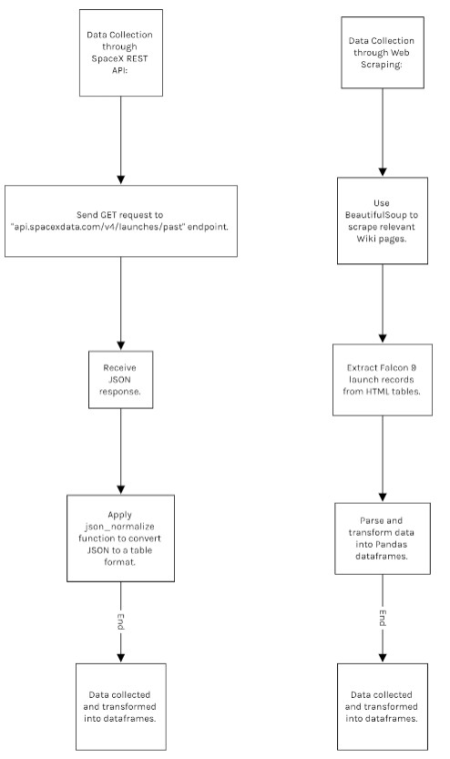
Data Collection
Describe how data sets were collected.
Data sets for this project were collected through the SpaceX REST API, specifically the "api.spacexdata.com/v4/launches/past" endpoint, using a GET request and the requests library.
The resulting JSON response, representing launches, was converted into a flat table format using the json_normalize function.
Additionally, web scraping with BeautifulSoup was employed to extract Falcon 9 launch records from HTML tables on relevant Wiki pages, which were then parsed and transformed into Pandas dataframes for analysis.
7

Slide 8
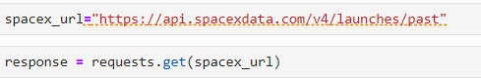
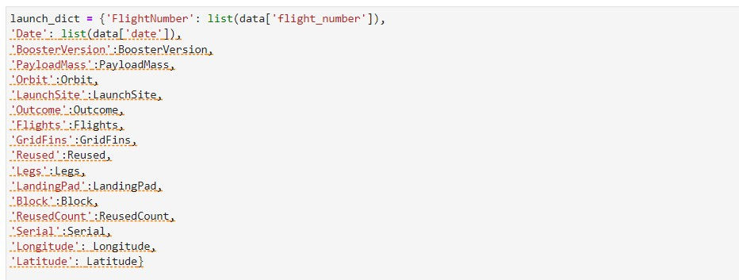
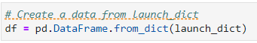
Data Collection – SpaceX API
1. Send GET request to "api.spacexdata.com/v4/launches/past" endpoint.
Data collection with SpaceX REST calls
Receive JSON response containing launch data. Apply json_normalize
function to convert the JSON into a flat table format.
Apply functions
https://github.com/sachi
-shah/IBM-Data-Science- Professional- Certificate/blob/main/Ca pstone%20Project/Spac eX_Collecting%20the% 20data_jupyter-labs- spacex-data-collection- api.ipynb
4. Data from the SpaceX REST API is collected and converted into a table
format.
8

Slide 9
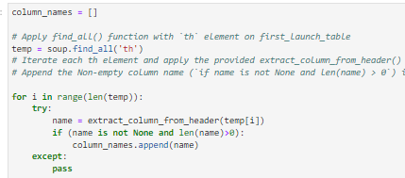
Data Collection - Scraping
Begin the web scraping process.
Use BeautifulSoup package to scrape relevant Wiki
pages.
Extract Falcon 9 launch records from HTML tables.
Parse the extracted data.
Web-scraping from wikipedia
https://github.com/sachi-shah/IBM- Data-Science-Professional- Certificate/blob/main/Capstone%20P roject/SpaceX_Data%20wrangling_ju pyter-labs-webscraping.ipynb
5. Transform the parsed data into Pandas datafra⁹mes.

Slide 10
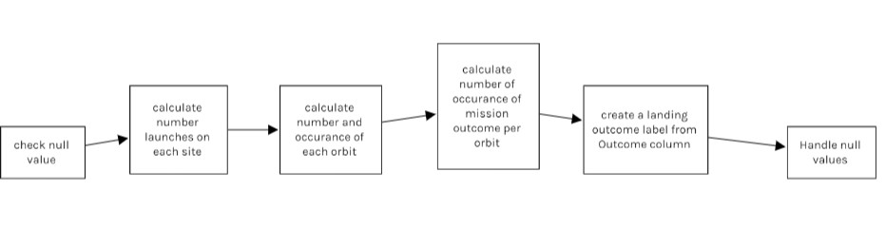
Data Wrangling
check null value
calculate number launches on each site
calculate number and occurance of each orbit
calculate number of occurance of mission outcome per orbit
create a landing outcome label from Outcome column
Handle null values
https://github.com/sachi-shah/IBM-Data-Science-Professional-
Certificate/blob/main/Capstone%20Project/SpaceX_Data%20wrangling_jupyter-labs-webscraping.ipynb
10

Slide 11
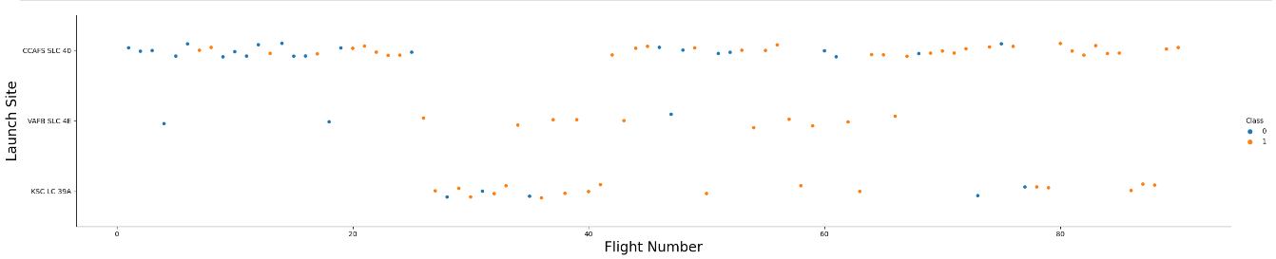
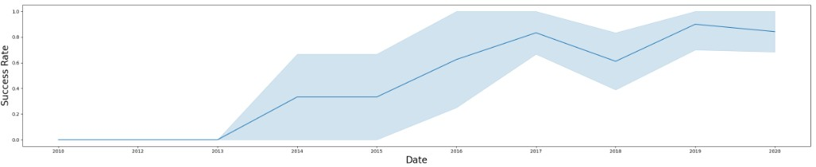
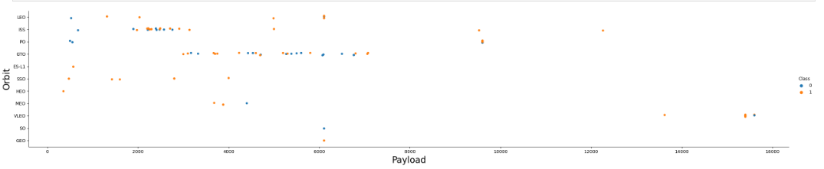
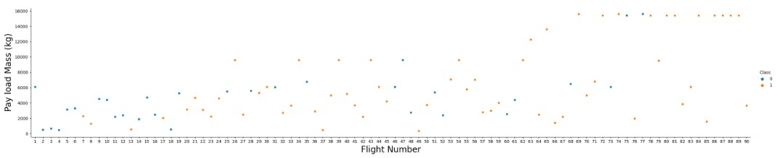
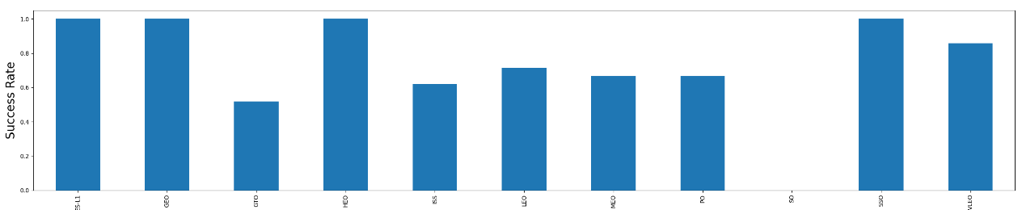
EDA with Data Visualization
https://github.com/sachi-shah/IBM-Data-Science-Professional- Certificate/blob/main/Capstone%20Project/SpaceX_%20Exploring andPreparingData_IBM-DS0321EN- SkillsNetwork_labs_module_2_jupyter-labs-eda- dataviz.ipynb.jupyterlite.ipynb
11

Slide 12
EDA with SQL
Display the names of the unique launch sites in the space mission
Display 5 records where launch sites begin with the string 'CCA'
Display the total payload mass carried by boosters launched by NASA (CRS)
Display average payload mass carried by booster version F9 v1.1
List the date when the first succesful landing outcome in ground pad was acheived.
List the names of the boosters which have success in drone ship and have payload mass greater than 4000 but less than 6000
List the total number of successful and failure mission outcomes
List the names of the booster_versions which have carried the maximum payload mass. Use a subquery
List the records which will display the month names, failure landing_outcomes in drone ship ,booster versions, launch_site for the months in year 2015.
Rank the count of successful landing_outcomes between the date 04-06-2010 and 20-03-2017 in descending order.
https://github.com/sachi-shah/IBM-Data-Science-Professional-Certificate/blob/main/Capstone%20Project/SpaceX_EDA_jupyt₁e₂r- labs-eda-sql-coursera_sqllite.ipynb

Slide 13
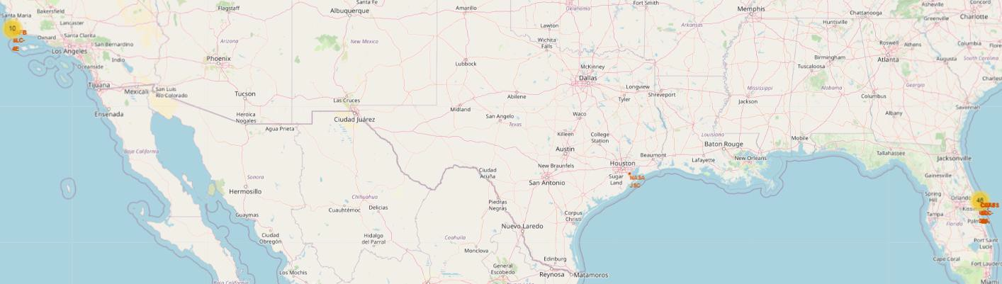
Build an Interactive Map with Folium
Map markers have been added to the map with aim to finding an optimal location for building an launch
https://github.com/sachi-shah/IBM-Data-Science-Professional- Certificate/blob/main/Capstone%20Project/SpaceX_site_location_IBM-DS0321EN- SkillsNetwork_labs_module_3_lab_jupyter_launch_site_location.jupyterlite.ipynb
13

Slide 14
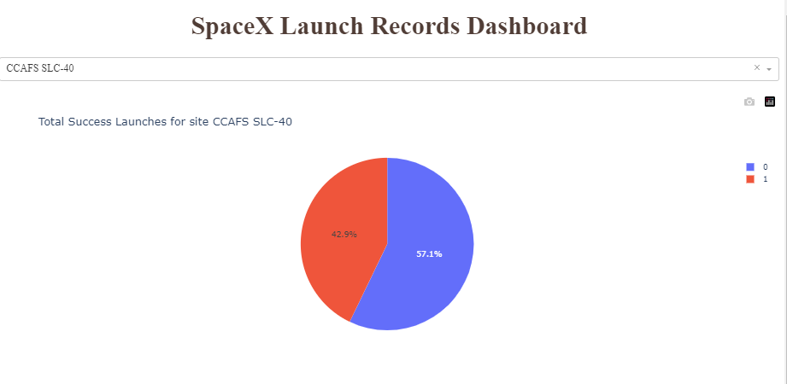
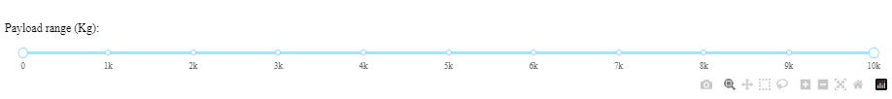
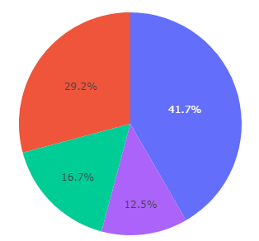
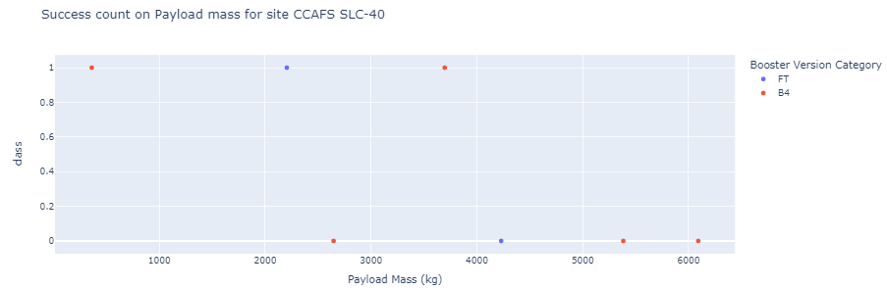
Build a Dashboard with Plotly Dash
This dashboard application contains input components such as a dropdown list and a range slider to interact with a pie chart and a scatter point chart.
https://github.com/sachi-shah/IBM-Data- Science-Professional- Certificate/blob/main/Capstone%20P1r4oject/s pacex_dash_app.py

Slide 15
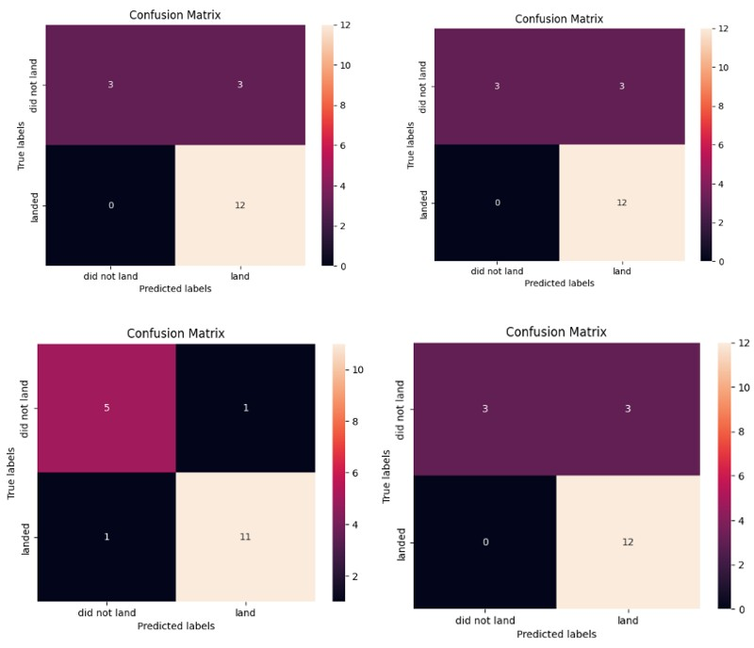
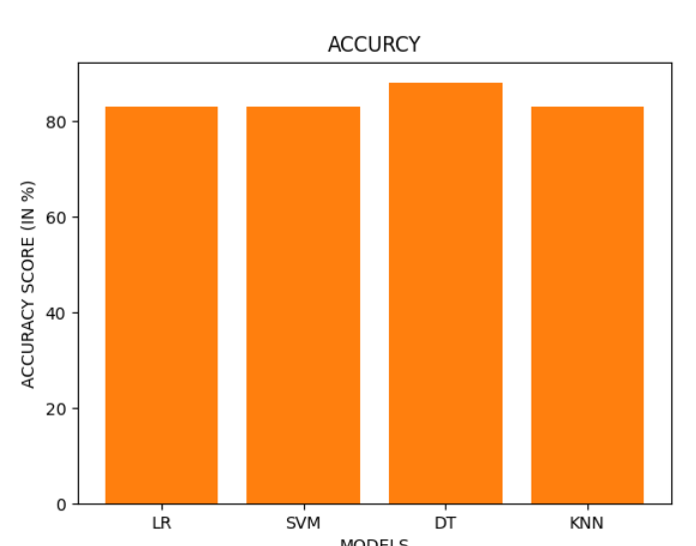
Predictive Analysis (Classification)
https://github.com/sachi-shah/IBM-Data-Science-Professional- Certificate/blob/main/Capstone%20Project/SpaceX_Machine_Learning_Predictio n_IBM-DS0321EN-SkillsNetwork_labs_module_4_Part_5.jupyterlite.ipynb
15

Slide 16
Results
The Decision Tree models are the best in terms of prediction accuracy for this
dataset.
Low weighted payloads perform better than the heavier payloads.
• The success rates for SpaceX launches is directly proportional time in years
they will eventually perfect the launches
KSC LC 39A had the most successful launches from all the sites.
16
• Orbit GEO,HEO,SSO,ES L1 has the best Success Rate.

Slide 17

Section 2

Slide 18
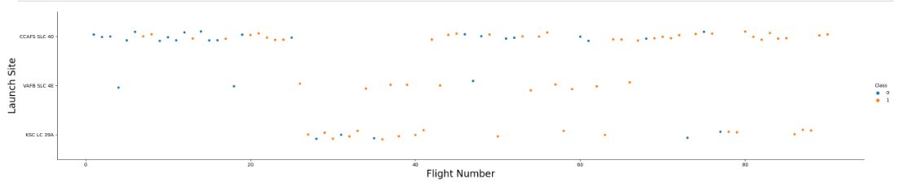
Flight Number vs. Launch Site
Launches from the site of CCAFS SLC 40 are significantly higher than launches form other sites.

Slide 19
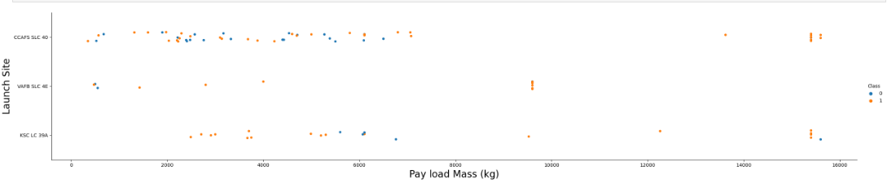
Payload vs. Launch Site
The majority of Pay Loads with lower Mass have been launched from CCAFS SLC 40

Slide 20
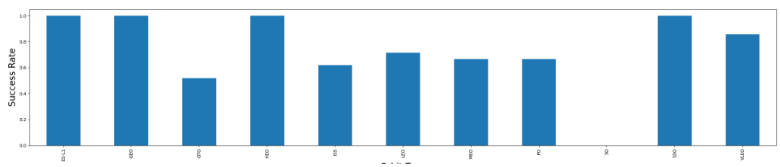
Success Rate vs. Orbit Type
The orbit types of ES-L1, GEO, HEO, SSO are among the highest success rate.

Slide 21
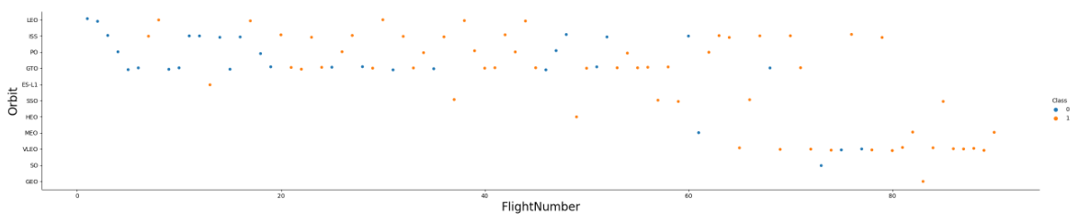
Flight Number vs. Orbit Type
A trend can be observed of shifting to VLEO launches in recent years.

Slide 22
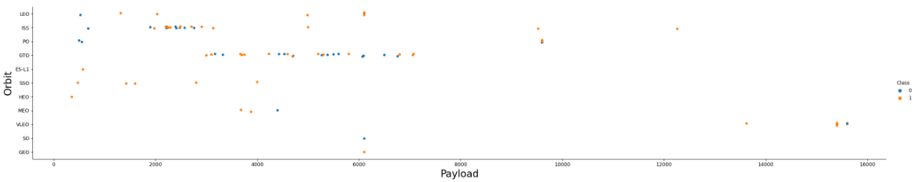
Payload vs. Orbit Type
There are strong correlation between ISS and Payload at the range around 2000, as well as between GTO and the range of 4000-8000.

Slide 23
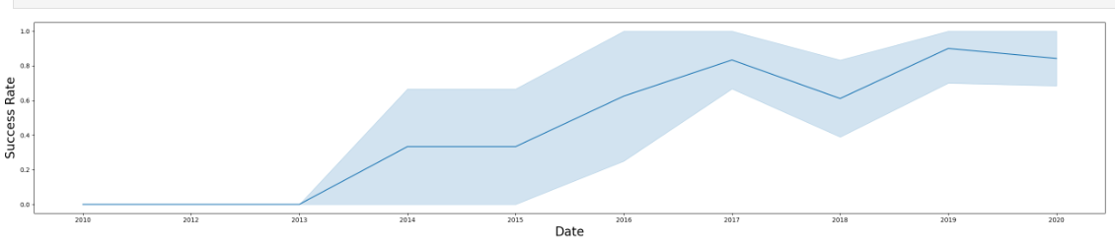
Launch Success Yearly Trend
Launch success rate has increased significantly since 2013 and has stablized since 2019, potentially due to advance in
technology.

Slide 24
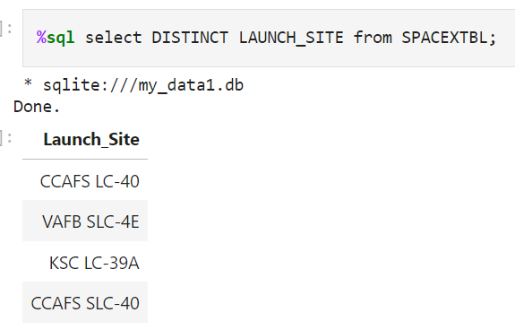
All Launch Site Names

Slide 25
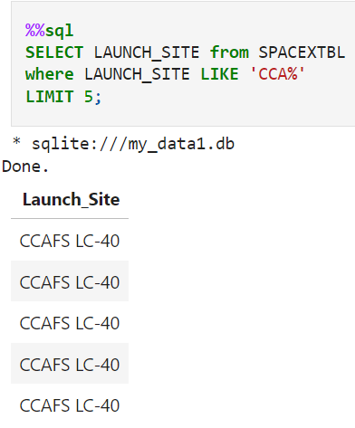
Launch Site Names Begin with 'CCA'

Slide 26
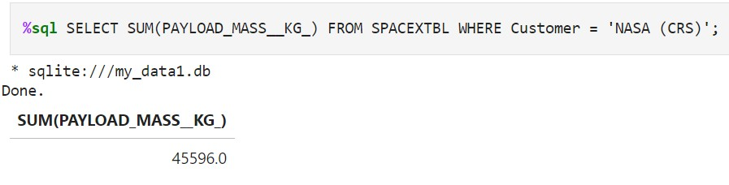
Total Payload Mass

Slide 27
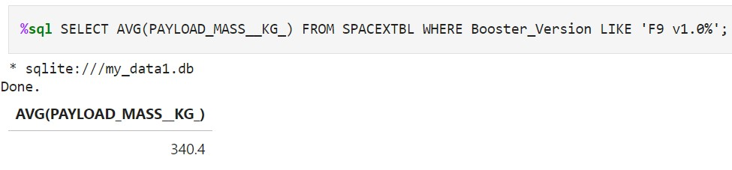
Average Payload Mass by F9 v1.1

Slide 28
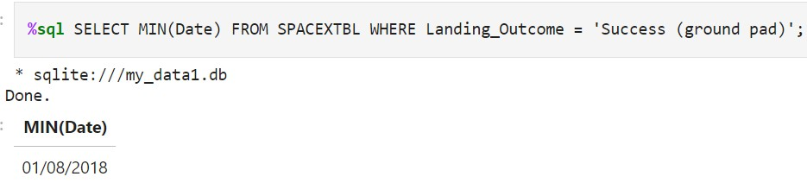
First Successful Ground Landing Date

Slide 29
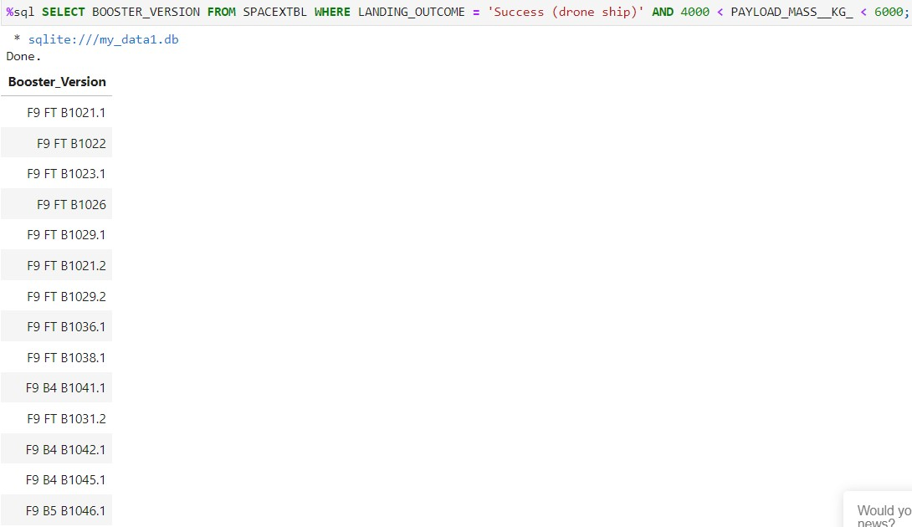
Successful Drone Ship Landing with Payload between 4000 and 6000

Slide 30
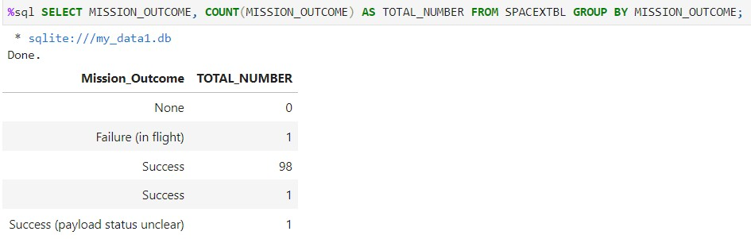
Total Number of Successful and Failure Mission Outcomes

Slide 31
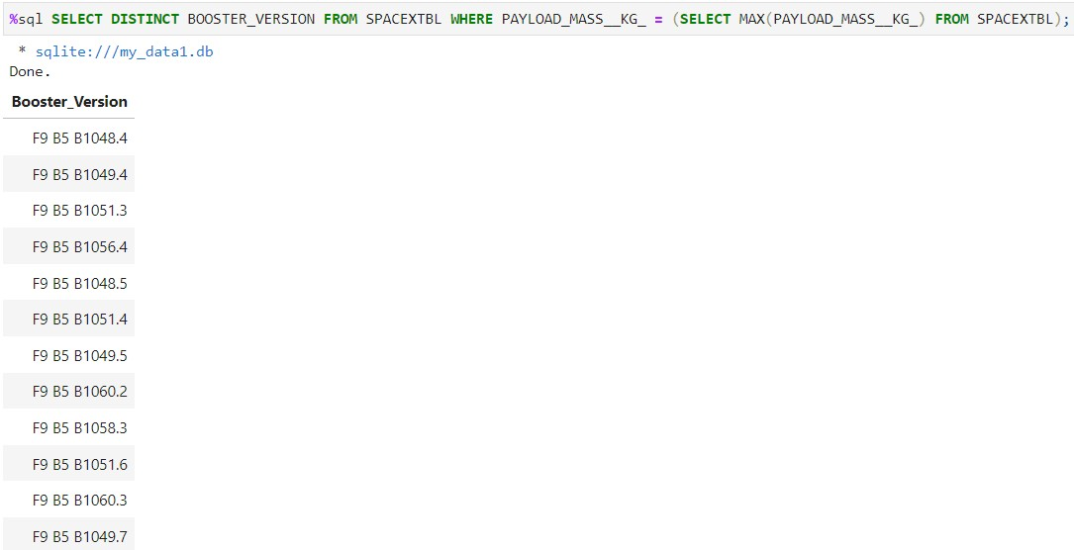
Boosters Carried Maximum Payload
List the names of the booster which have carried the maximum payload mass
Present your query result with a short explanation here

Slide 32
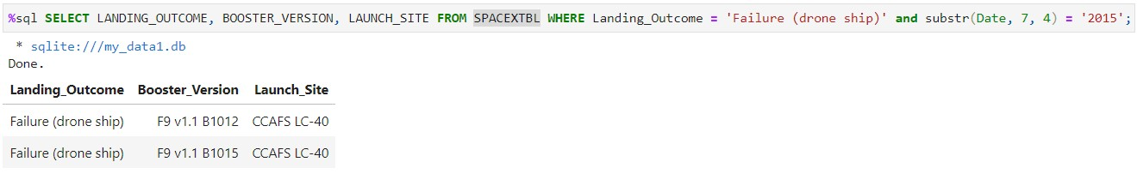
2015 Launch Records

Slide 33
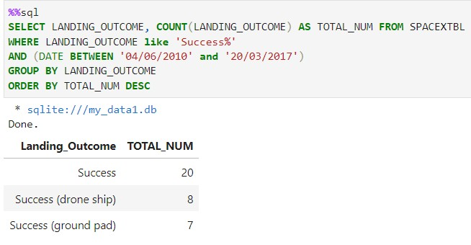
Rank Landing Outcomes Between 2010-06-04 and 2017-03-20

Slide 34

Section 3

Slide 35
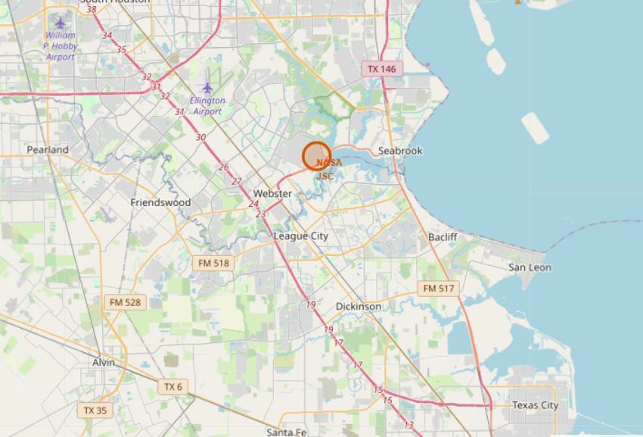
All launch sites marked on map

Slide 36
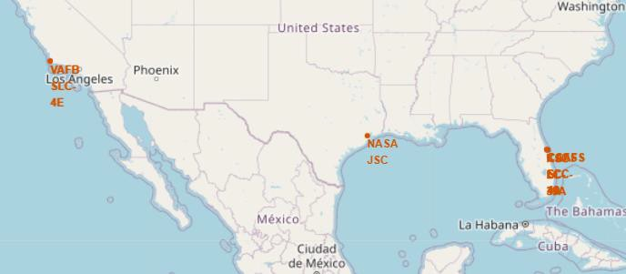
Success/failed launces marked on map

Slide 37
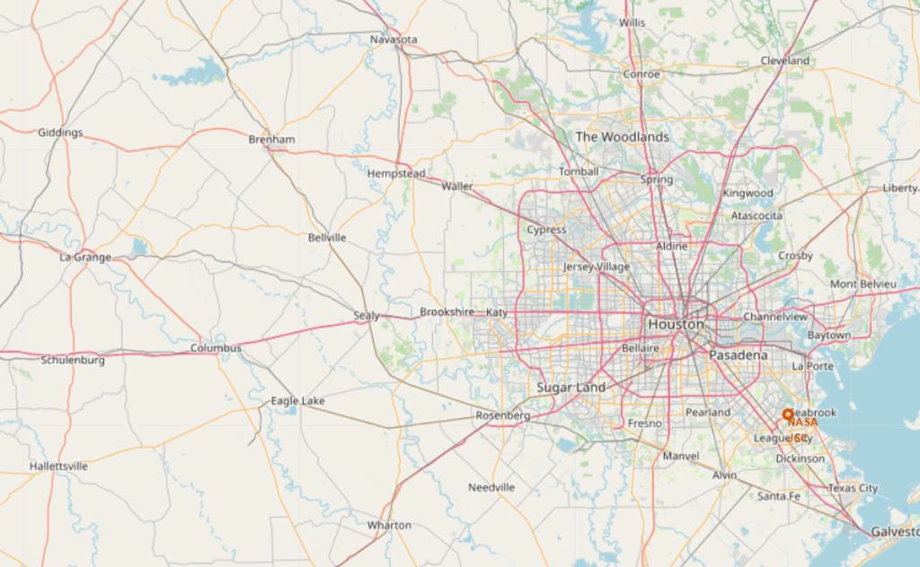
Launces marked on map

Slide 38

Section 4

Slide 39
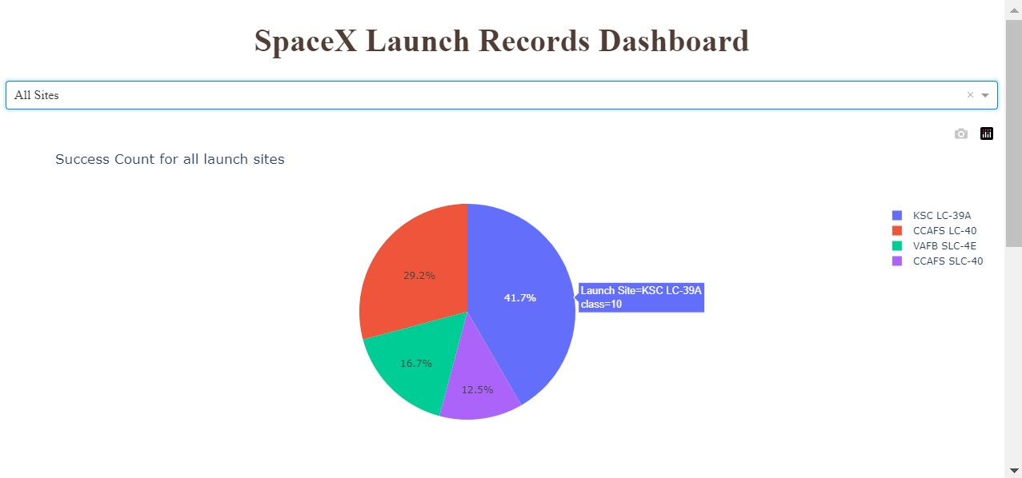
Total success launches by all sites
• We can see that KSC-LC-39A had the most successful launches from all sites
39

Slide 40
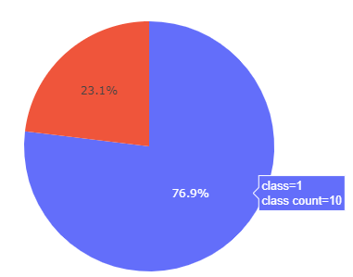
Success rate by site
KSC-LC-39A achieved a 76.9% success rate while getting a 23.1% failure rate

Slide 41
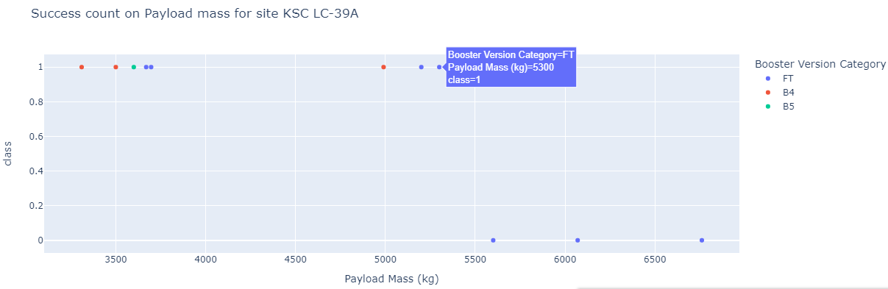
Payload and launch outcome
Success rates for low weighted payloads is higher than heavy weighted payloads

Slide 42

Section 5

Slide 43
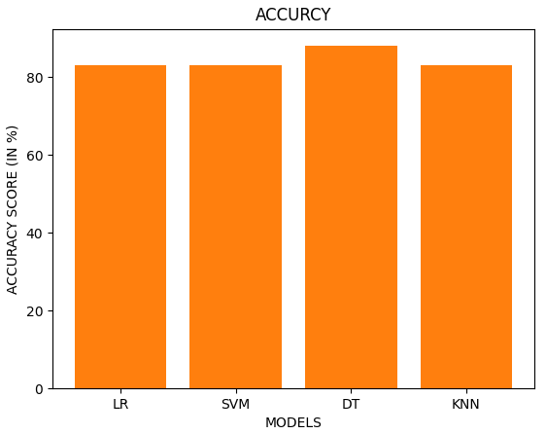
Classification Accuracy

Slide 44
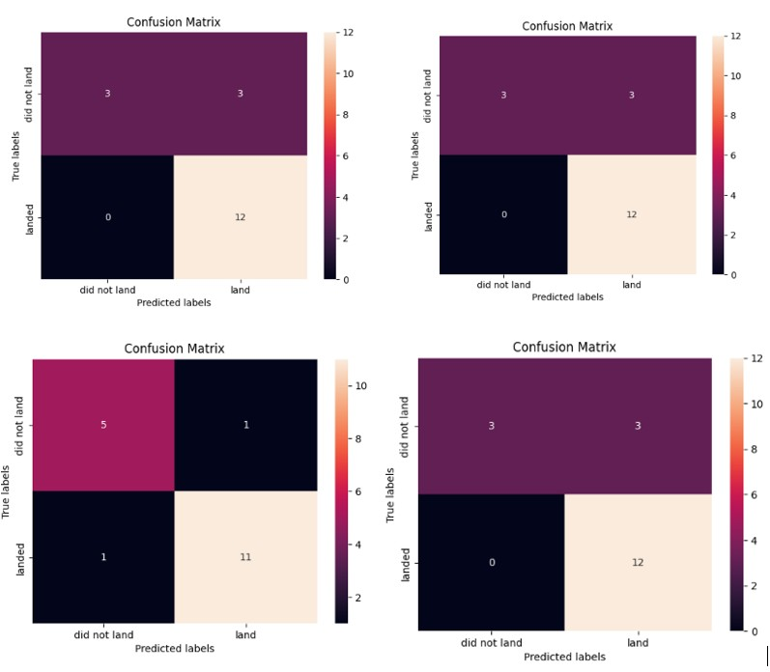
Confusion Matrix

Slide 45
Conclusions
The Decision Tree model is the best in terms of prediction accuracy for this
dataset.
Low weighted payloads perform better than the heavier payloads.
The success rates for SpaceX launches is directly proportional time in years they will eventually perfect the launches.
KSC LC 39A had the most successful launches from all the sites.
Orbit GEO,HEO,SSO,ES L1 has the best Success Rate.

Slide 46
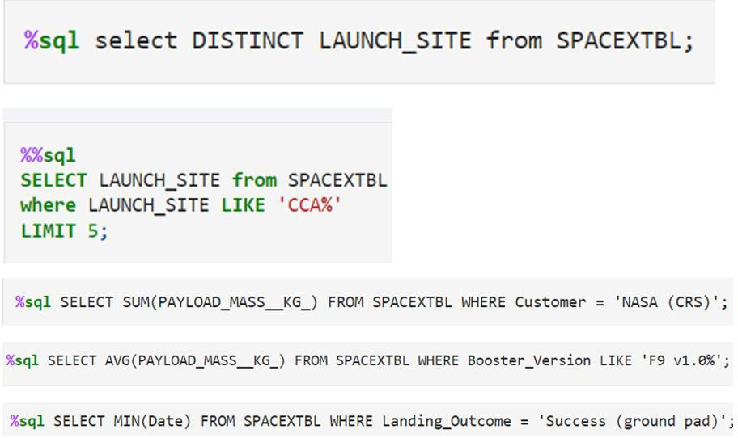
Appendix
Include any relevant assets like Python code snippets, SQL queries, charts,
Notebook outputs, or data sets that you may have created during this project

Slide 47


